Slide 1
Chapter 10 Hands on Machine Learning
황 성 윤
Reference : https://github.com/rickiepark/handson-ml

Slide 2
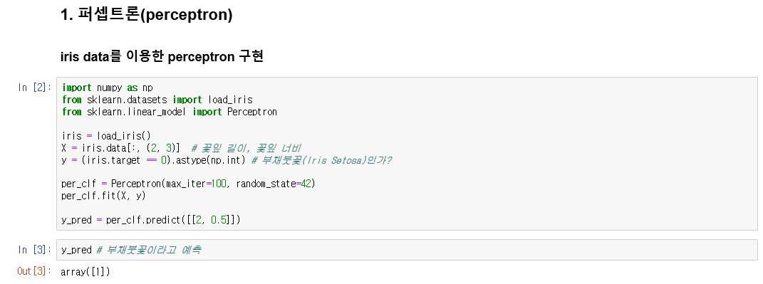
Chapter 10

Slide 3
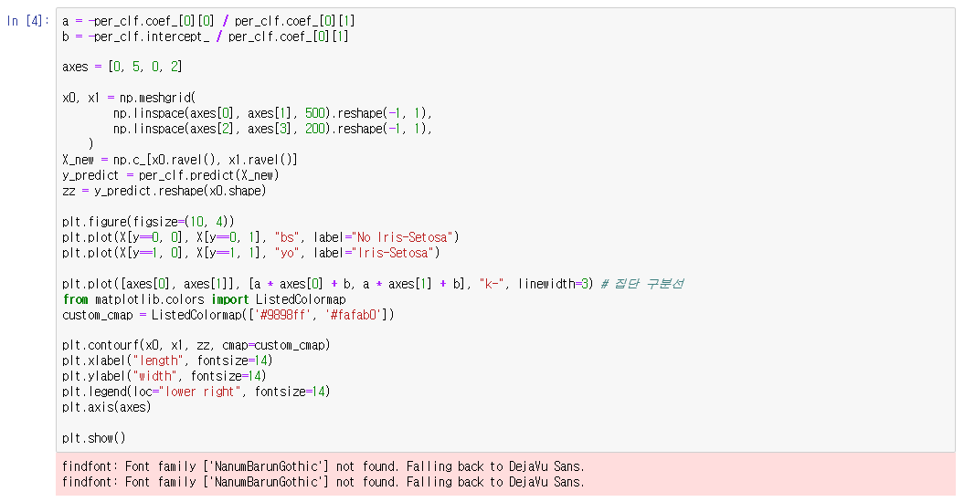
Chapter 10

Slide 4
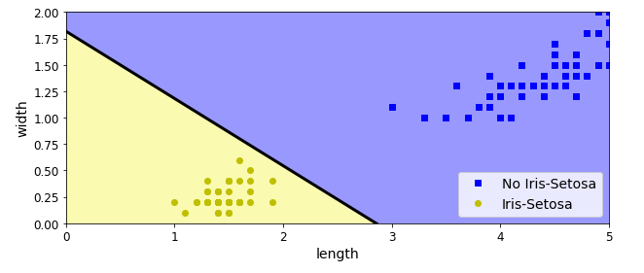
Chapter 10

Slide 5
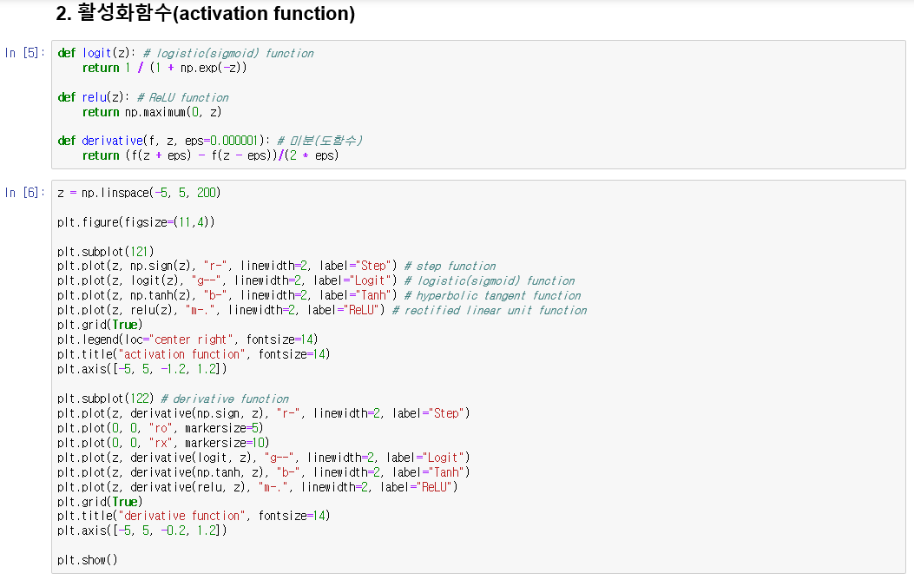
Chapter 10

Slide 6
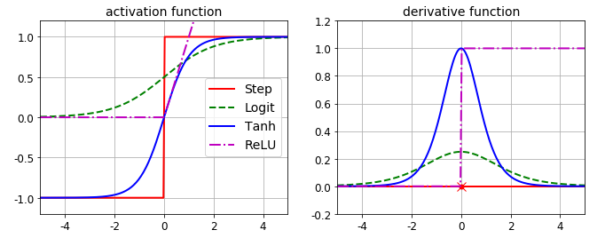
Chapter 10

Slide 7
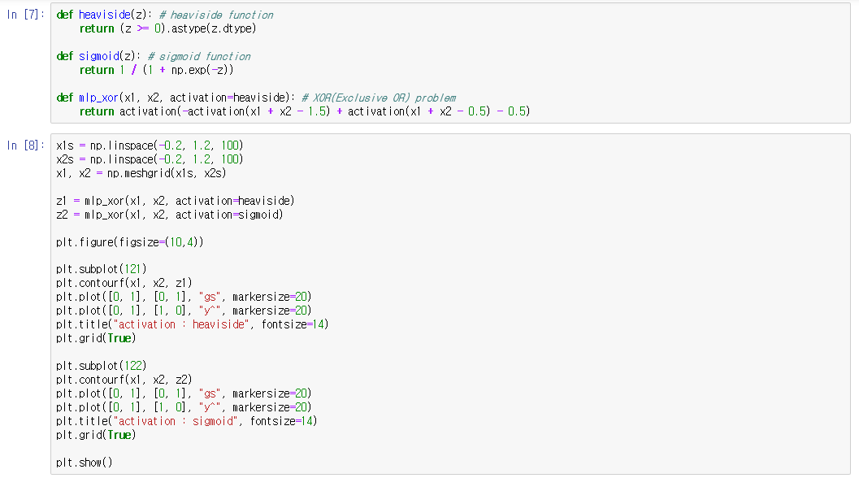
Chapter 10

Slide 8
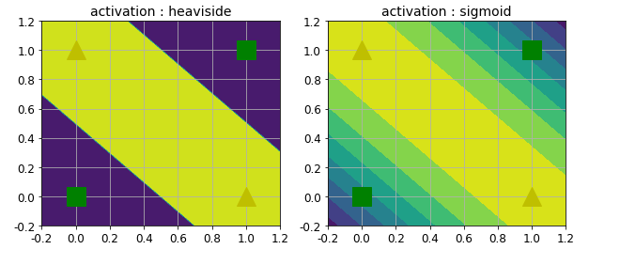
Chapter 10

Slide 9
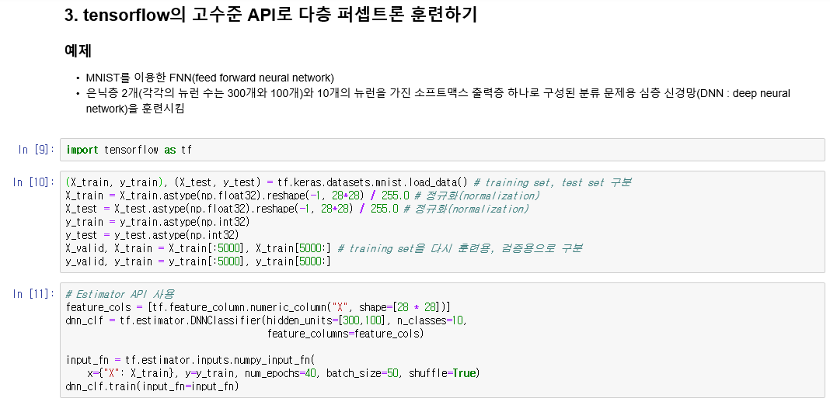
Chapter 10

Slide 10
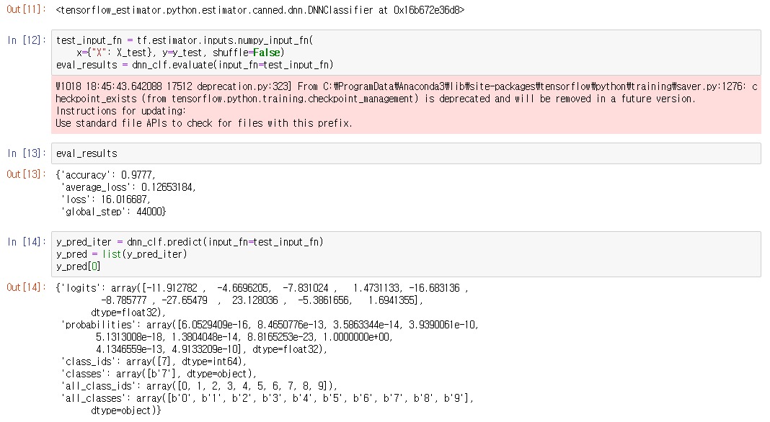
Chapter 10

Slide 11
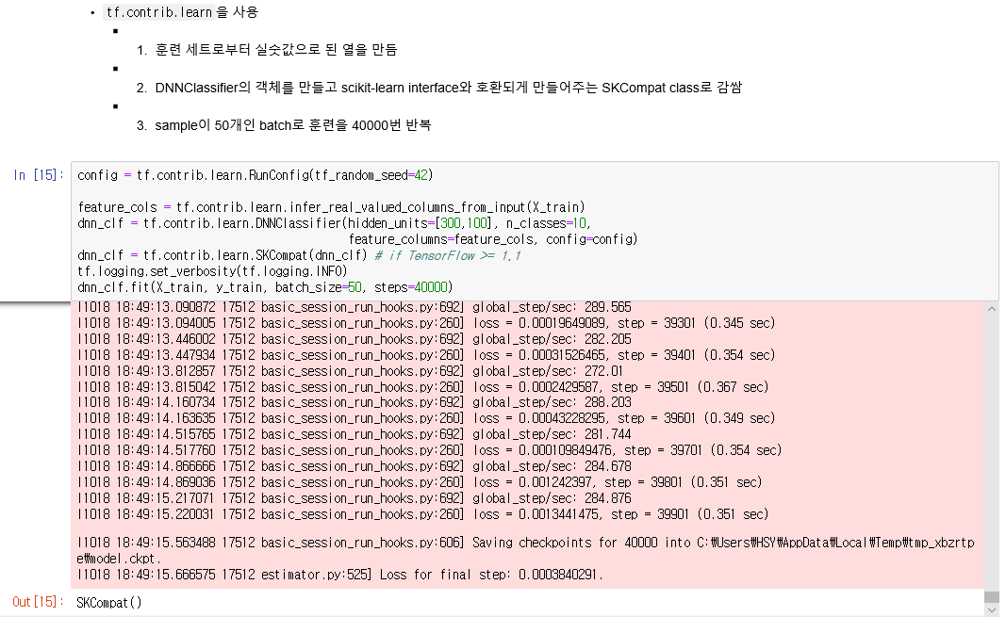
Chapter 10

Slide 12
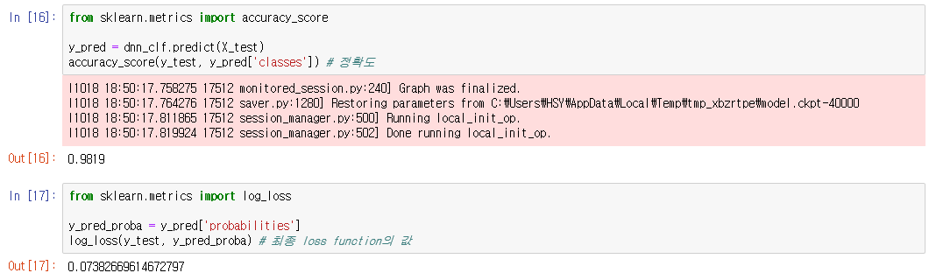
Chapter 10

Slide 13
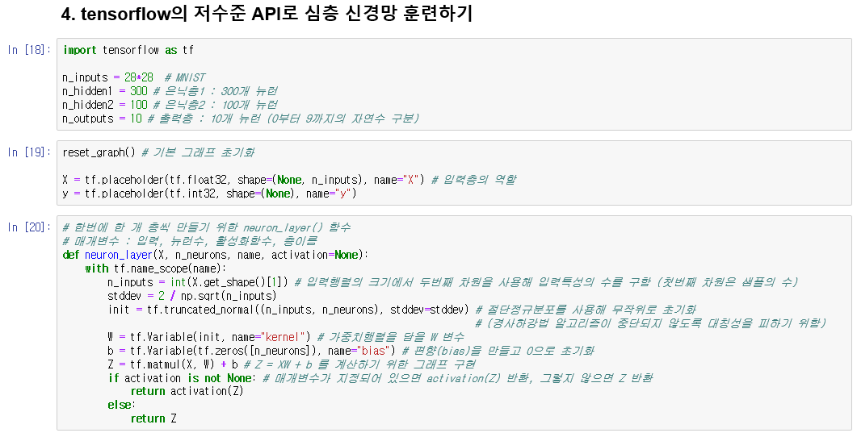
Chapter 10

Slide 14
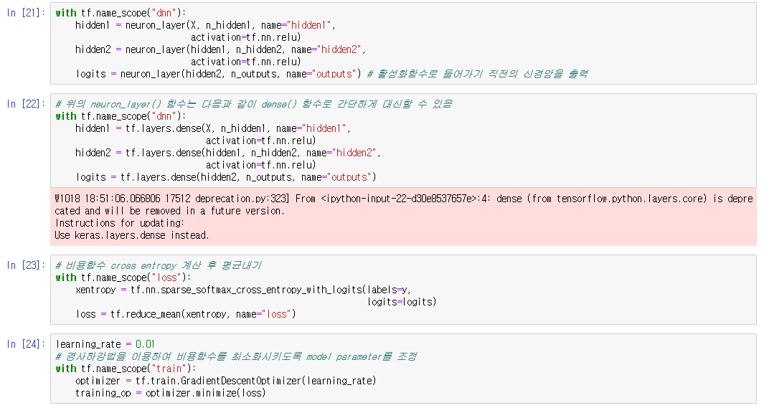
Chapter 10

Slide 15
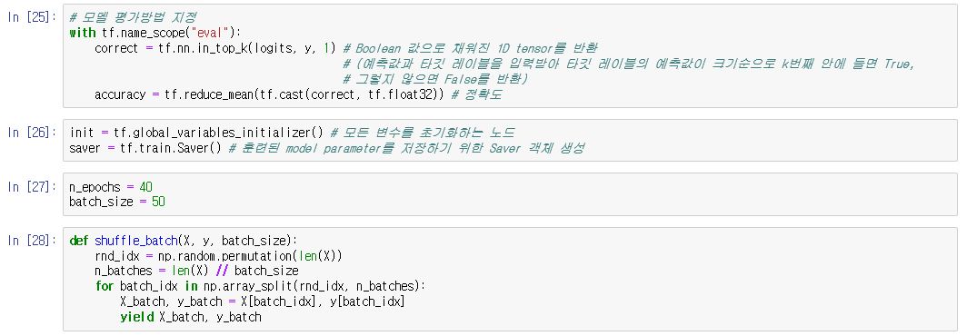
Chapter 10

Slide 16
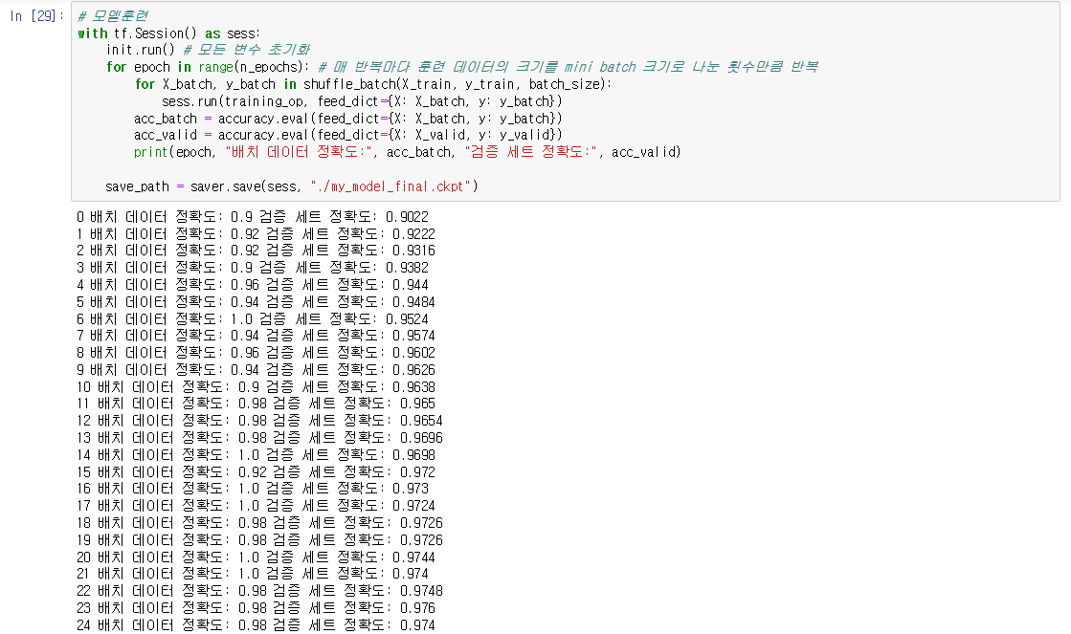
Chapter 10

Slide 17
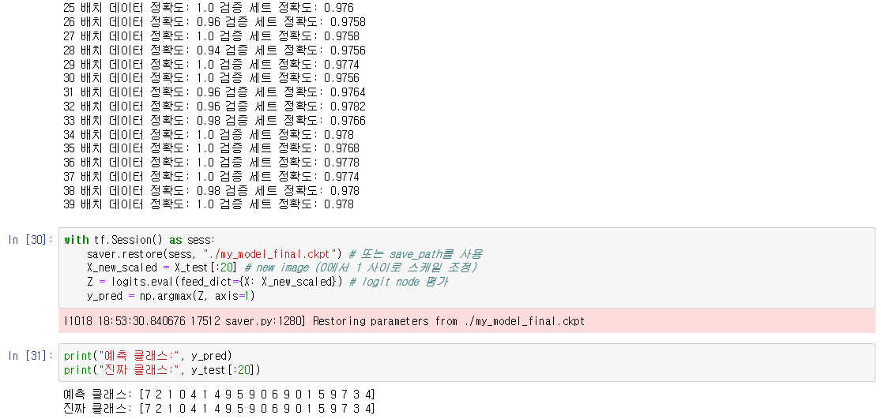
Chapter 10

Slide 18
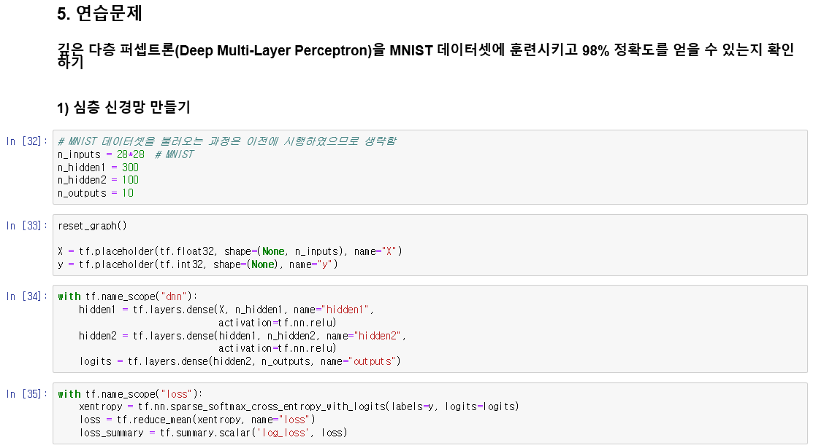
Chapter 10

Slide 19
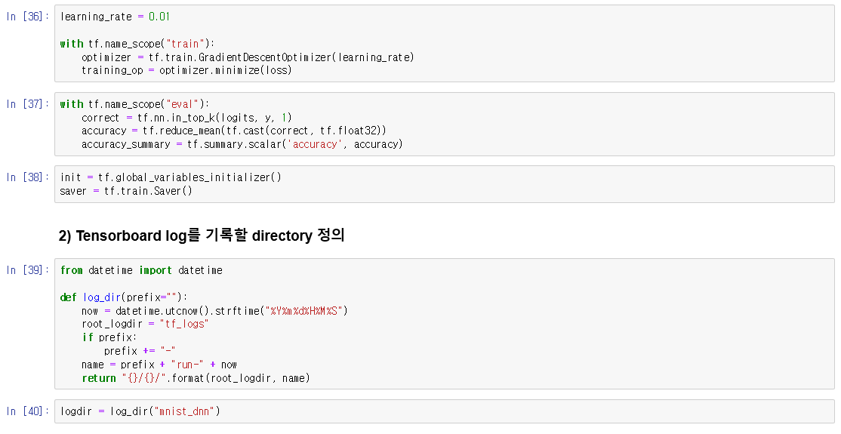
Chapter 10

Slide 20
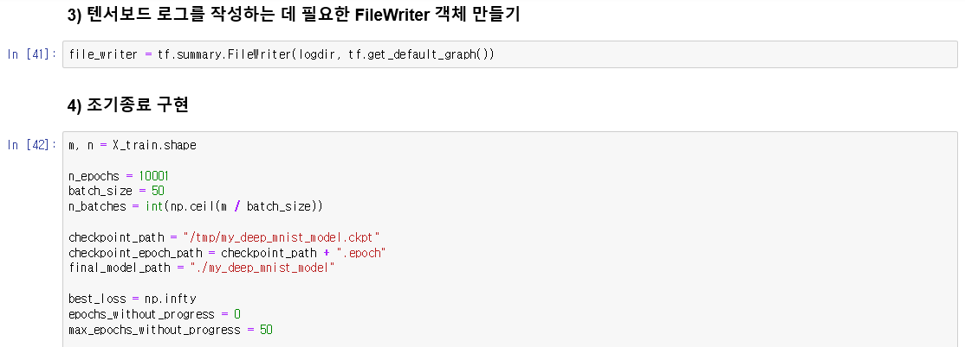
Chapter 10

Slide 21
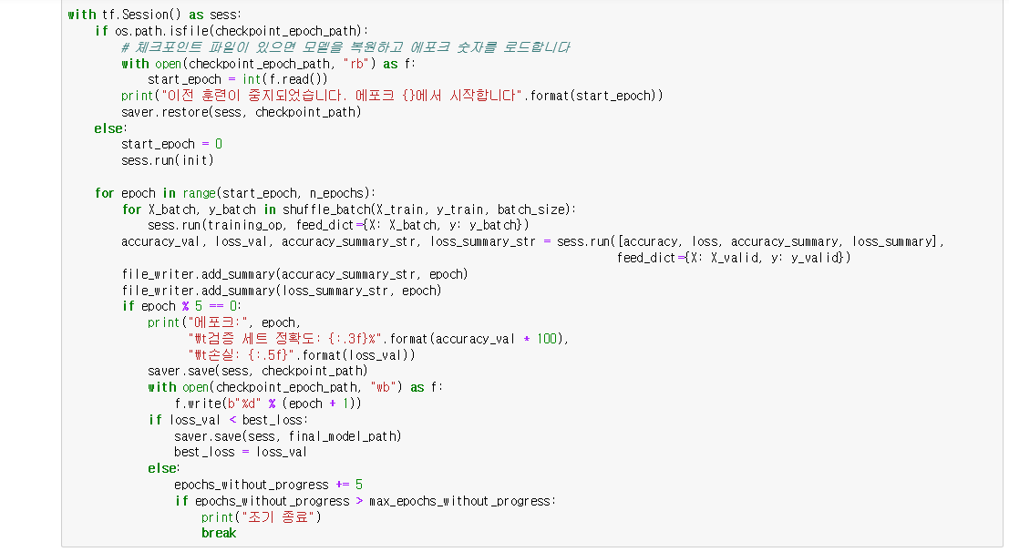
Chapter 10

Slide 22
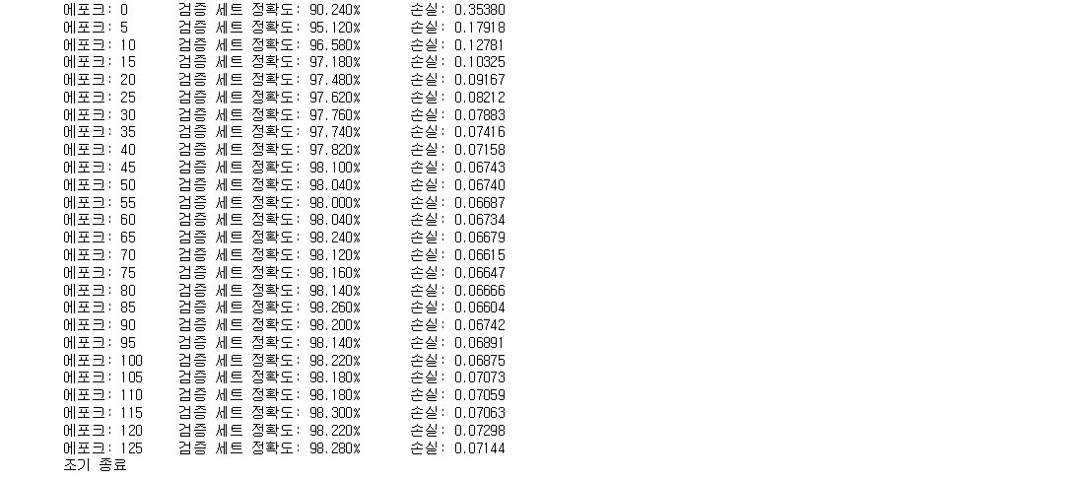
Chapter 10

Slide 23
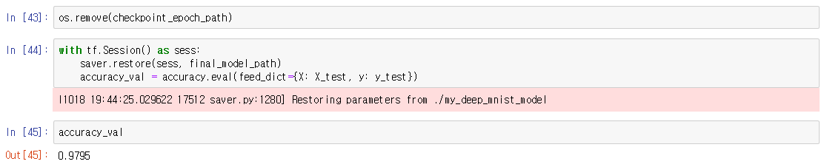
Chapter 10

